Slide 1

UNIVERSITY OF BUEA FACULTY OF ENGINEERING AND TECHNOLOGY DEPARTMENT OF COMPUTER ENGINEERING LEVEL 300
SOFTWARE DEVELOPMENT TOOLS CEF 333
GROUP 1 PRESENTATION
Demonstrate The React.Js Application With Working Frontend-backend
Communication
S/N | GROUP MEMBER | MATRICULATION NUMBER
1. | LENYA SHAMPEL LENYA | FE23A001
2. | ACHUO PLACID ACHUO-ASSAM | FE23A004
3. | AFUH CHIKE CHEWAKONDI | FE23A005
4. | AGBORNJA BESONG AKPAK DIVINE | FE23A006
5. | AKOH JUNIOR NGOH | FE23A008
COURSE FACILITATOR: DR. NKEMENI Valery
COURSE FACILITATOR: DR. NKEMENI Valery

Slide 2
INTRODUCTION TO REACT.JS
React.Js is a powerful javascript library used for building user interfaces, particularly single-page applications where you need a fast, interactive interface.
General Communication description: A React.js application communicates with a backend server using HTTP requests, sending and receiving data in JSON format. This communication is facilitated by an API that serves as an intermediary

Slide 3
KEY FEATURES (WHY USE REACT.JS)
Frontend Library/Framework: React.js is a JavaScript library, often considered a framework, used for building user interfaces.
Backend Communication: React.js interacts with a backend server through HTTP requests, exchanging data in JSON format. An API serves as an intermediary to facilitate communication. React uses the fetch API to make requests and updates its state based on the responses received from the backend
Ecosystem and Popularity: React.js has a large ecosystem of packages that can be installed to extend its functionality. It is one of the most popular frameworks in the industry

Slide 4
Key Tools and Concepts
JSON (JavaScript Object Notation): A data format used for exchanging structured information.
HTTP (Hypertext Transfer Protocol): The protocol used for communication between front and backend.
Fetch API: The browser API used to make HTTP requests.
JSON Server: A tool used to simulate a REST API for development.

Slide 5
BACKEND SETUP AND JSON BASED DATA EXCHANGE WITH THE FRONTEND
Data exchange in React.js occurs through HTTP requests using JSON. The UI updates based on this data flow, where child components receive props from parents and send actions back via callbacks. JSON Server can simulate an API for testing

Slide 6
SETTING UP THE NODE.JS BACKEND
This was done following the steps explained in the last presentation
Initializing the project repository
Installing Express
Creating our server
Running the server

Slide 7
SETTING UP THE FRONTEND (WITH REACT JS)
The steps involved were
Creating React app
Starting the react app

Slide 8
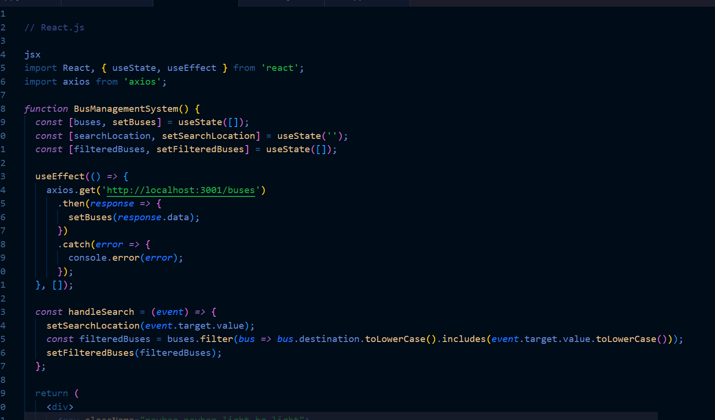
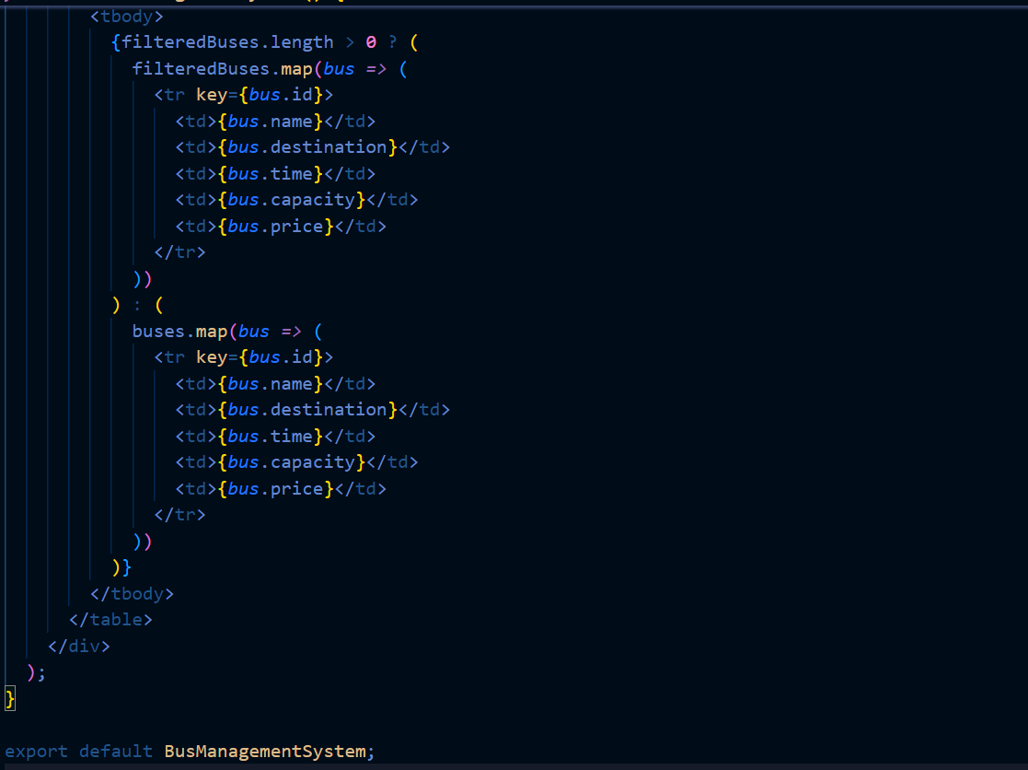
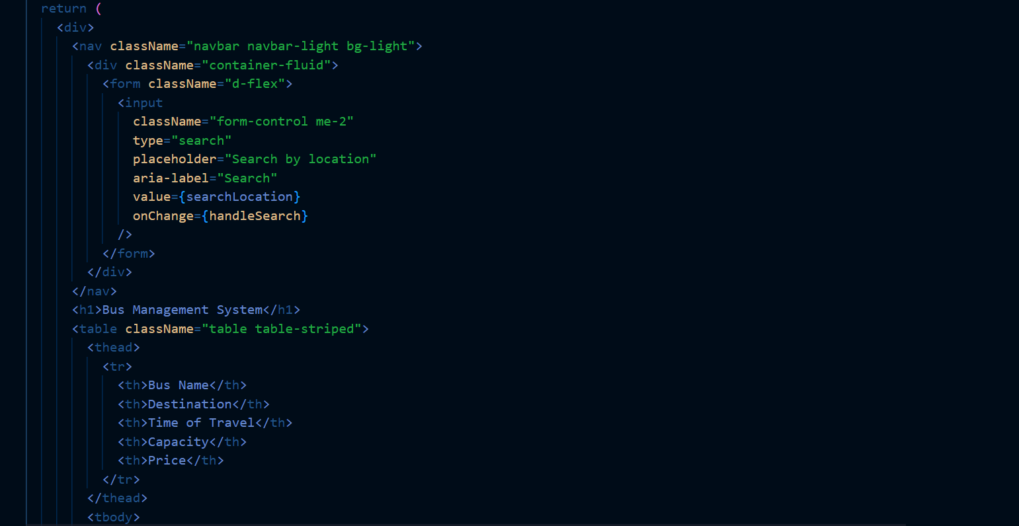
SHOWING FRONTEND-BACKEND COMMUNICATION
Fetch Data from Backend
Proxy Requests to Backend
Following these steps, it will enable backend to communicate with the REST API

Slide 9
BACKEND PROCESSING
The backend validates the request, accesses the database, and converts data into JSON format.
The backend sends an HTTP response with a status code and JSON data
React.js parses the JSON response and updates component state, causing UI re-rendering.

Slide 10
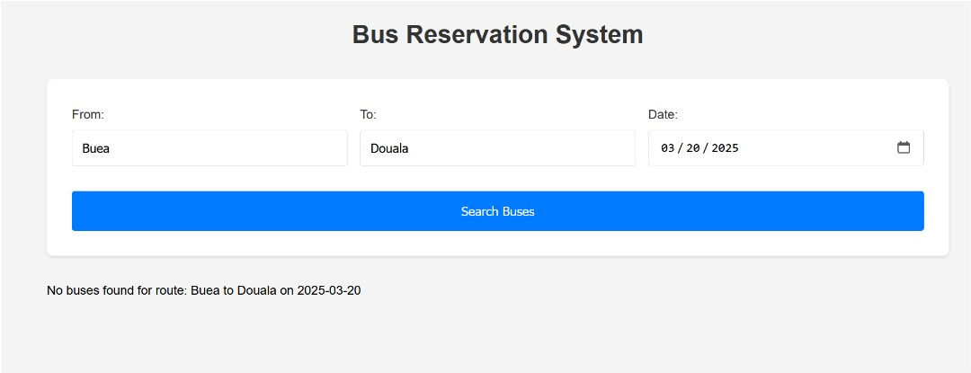
APPLICATION DEMONSTRATION

